Slide 1
Assignment 1
DYOR!
Read all chapters of “21 Lessons” and the Bitcoin whitepaper.
Summarize your key learnings from each chapter of “21 lessons.”
Summarize your key learnings from the Bitcoin whitepaper in your own words.
Practical: Bitcoin transaction
Obtain a Bitcoin address and send there some fractions of a Bitcoin.
Observe the transactions on the block explorer.
Also observe the mempool.
Present your observations
Work and record your findings in a Google Slides presentation for your presentation in the next session.
Create high-quality slides.
Include references and hints for the other participants.
REMINDER: In order to participate in the program, you need to fill out this FORM. We need your confirmation on this form for GDPR reasons. Please note that you cannot participate in the program without filling out the survey.

Slide 2
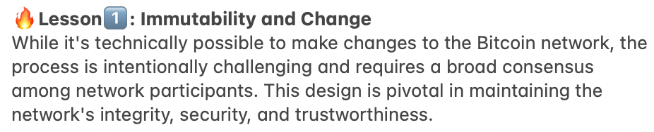
Assignment:1.Read all chapters of “21 Lessons” and the Bitcoin whitepaper.
1a.Summarize your key learnings from each chapter of “21 lessons.”

Slide 3
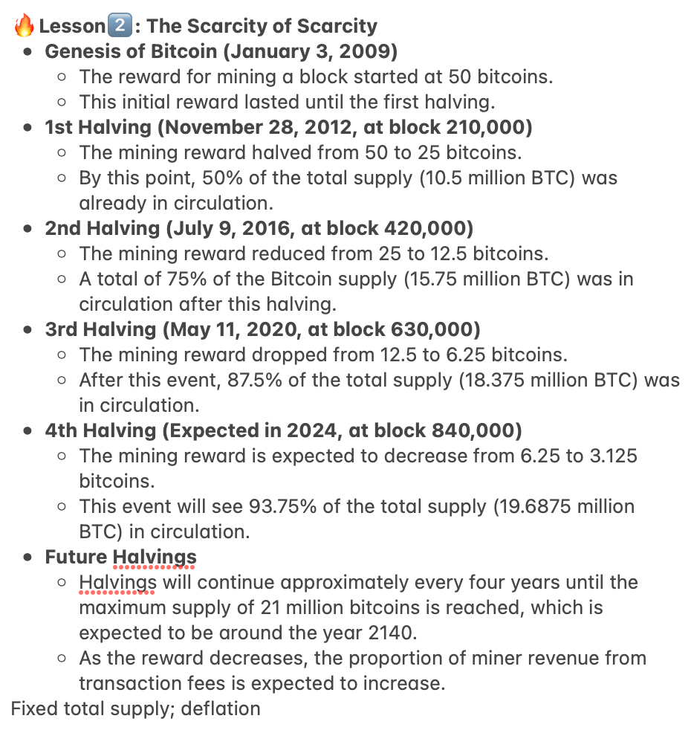
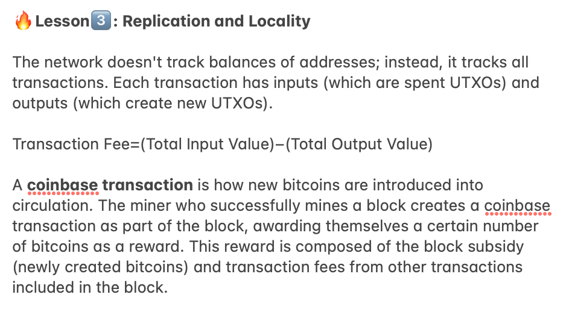
Assignment:1.Read all chapters of “21 Lessons” and the Bitcoin whitepaper.
1a.Summarize your key learnings from each chapter of “21 lessons.”

Slide 4
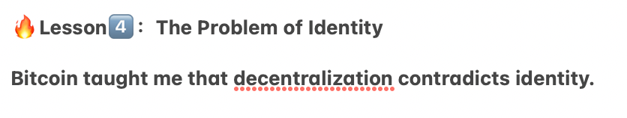
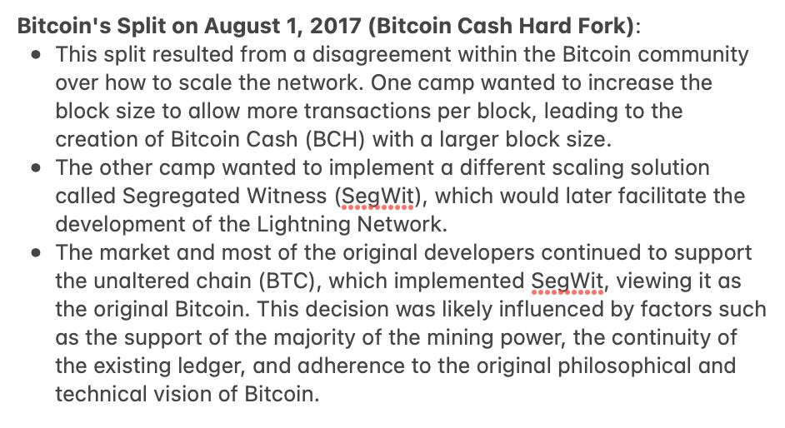
Assignment:1.Read all chapters of “21 Lessons” and the Bitcoin whitepaper.
1a.Summarize your key learnings from each chapter of “21 lessons.”

Slide 5
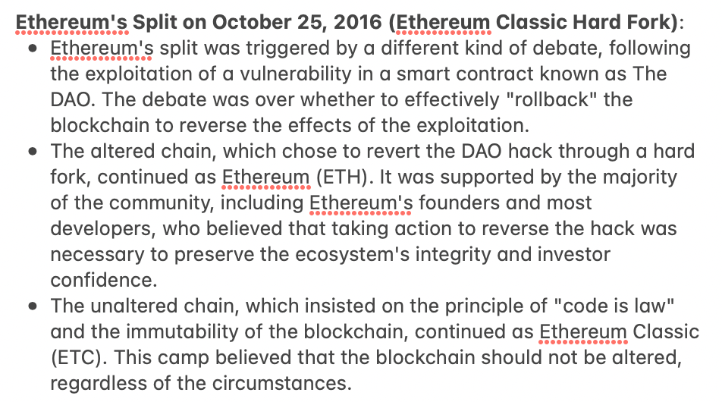
Assignment:1.Read all chapters of “21 Lessons” and the Bitcoin whitepaper.
1a.Summarize your key learnings from each chapter of “21 lessons.”

Slide 6
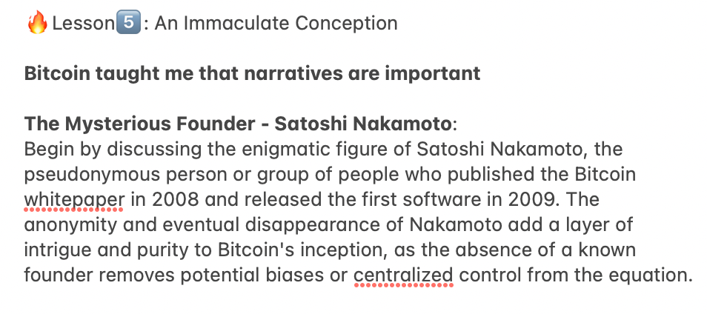
Assignment:1.Read all chapters of “21 Lessons” and the Bitcoin whitepaper.
1a.Summarize your key learnings from each chapter of “21 lessons.”

Slide 7
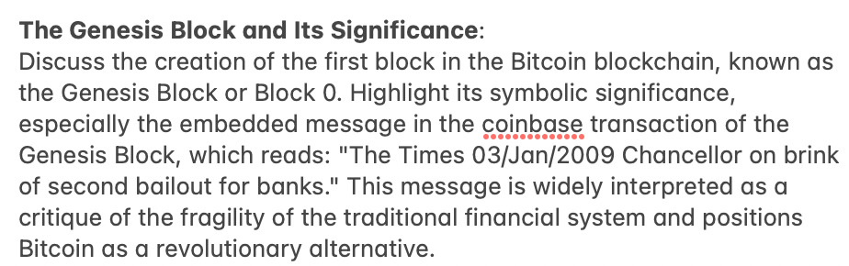
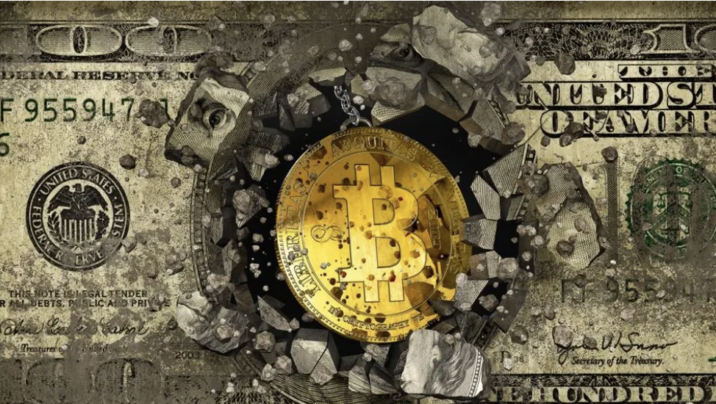
Assignment:1.Read all chapters of “21 Lessons” and the Bitcoin whitepaper.
1a.Summarize your key learnings from each chapter of “21 lessons.”

Slide 8
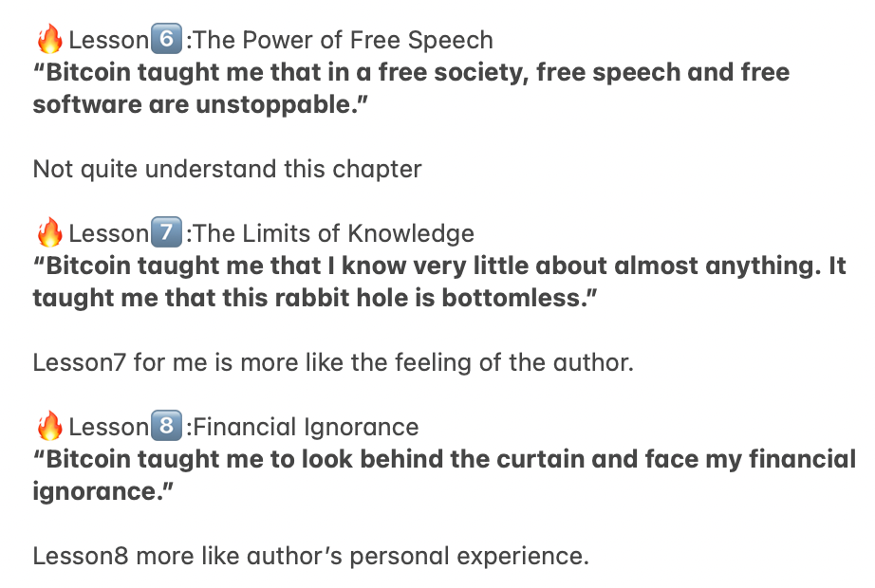
Assignment:1.Read all chapters of “21 Lessons” and the Bitcoin whitepaper.
1a.Summarize your key learnings from each chapter of “21 lessons.”

Slide 9
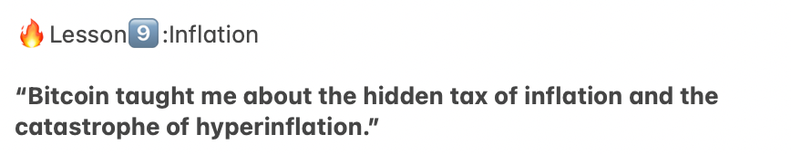
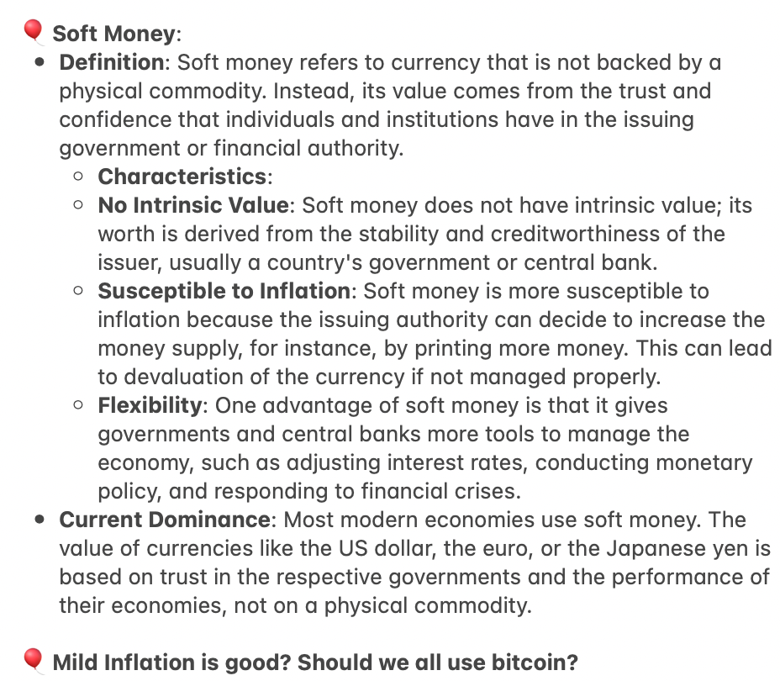
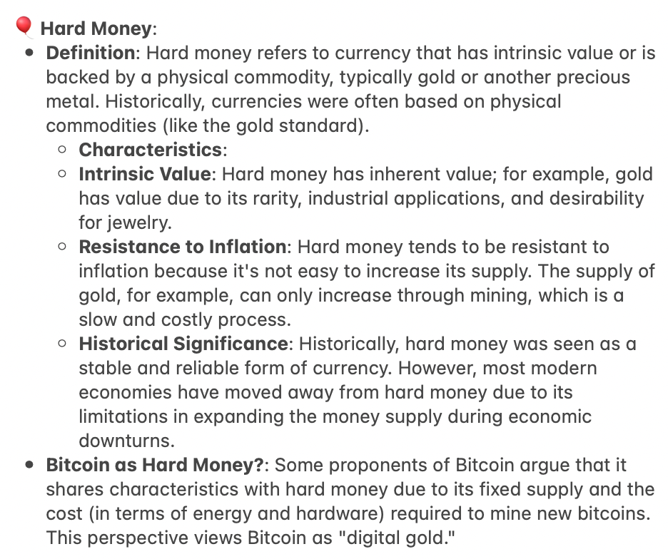
Assignment:1.Read all chapters of “21 Lessons” and the Bitcoin whitepaper.
1a.Summarize your key learnings from each chapter of “21 lessons.”

Slide 10
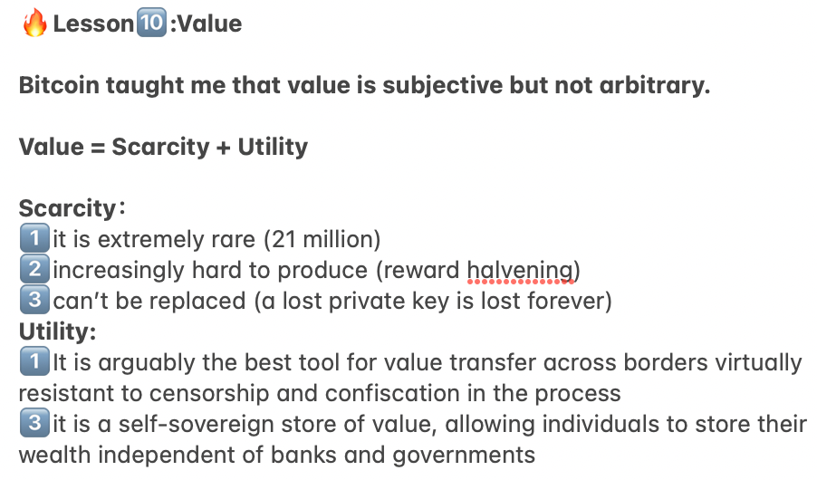
Assignment:1.Read all chapters of “21 Lessons” and the Bitcoin whitepaper.
1a.Summarize your key learnings from each chapter of “21 lessons.”

Slide 11
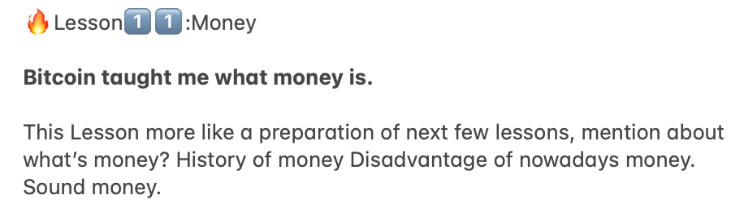
Assignment:1.Read all chapters of “21 Lessons” and the Bitcoin whitepaper.
1a.Summarize your key learnings from each chapter of “21 lessons.”

Slide 12
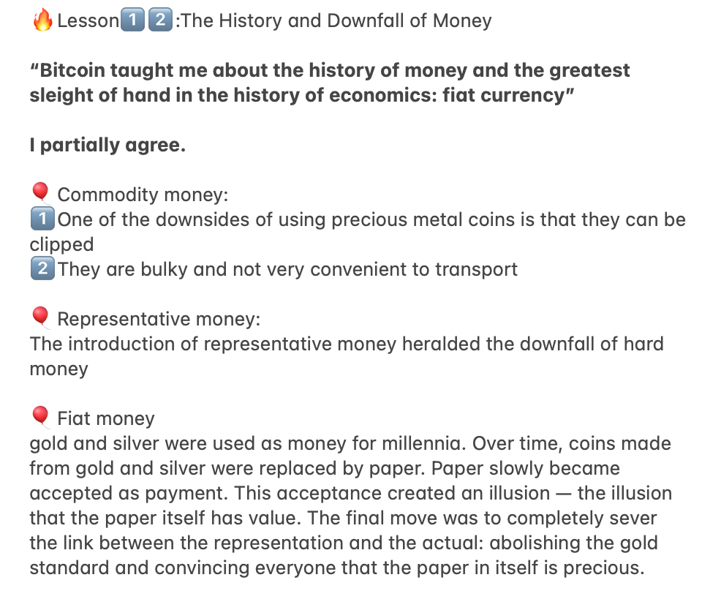
Assignment:1.Read all chapters of “21 Lessons” and the Bitcoin whitepaper.
1a.Summarize your key learnings from each chapter of “21 lessons.”

Slide 13
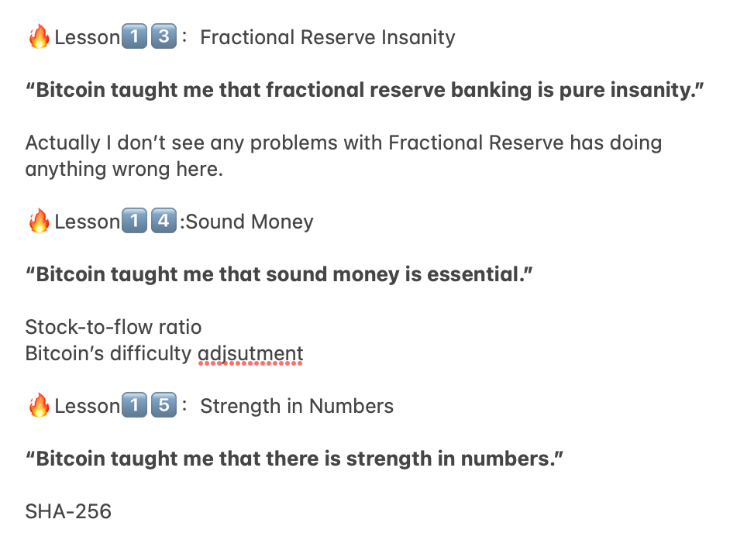
Assignment:1.Read all chapters of “21 Lessons” and the Bitcoin whitepaper.
1a.Summarize your key learnings from each chapter of “21 lessons.”

Slide 14
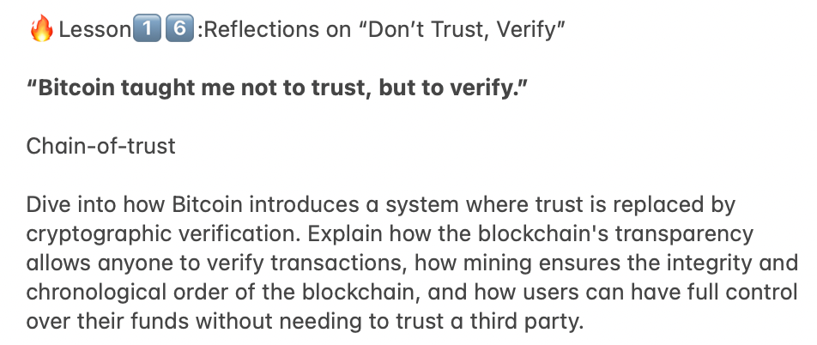
Assignment:1.Read all chapters of “21 Lessons” and the Bitcoin whitepaper.
1a.Summarize your key learnings from each chapter of “21 lessons.”

Slide 15
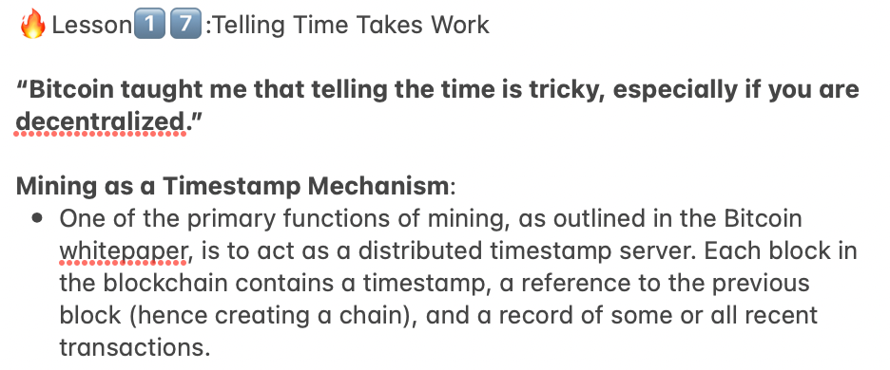
Assignment:1.Read all chapters of “21 Lessons” and the Bitcoin whitepaper.
1a.Summarize your key learnings from each chapter of “21 lessons.”

Slide 16
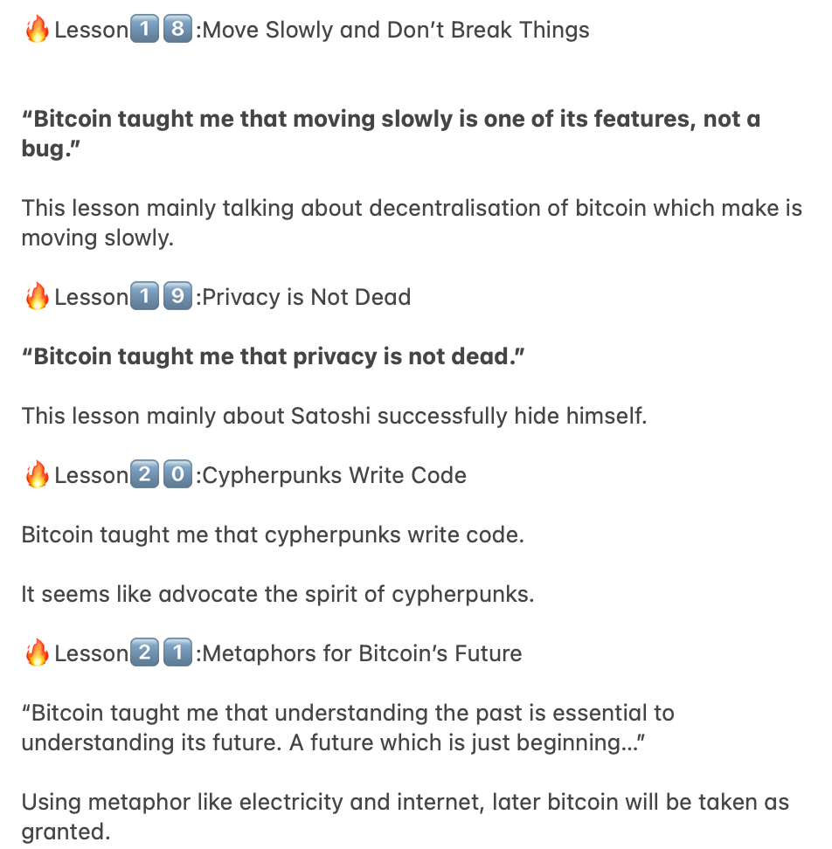
Assignment:1.Read all chapters of “21 Lessons” and the Bitcoin whitepaper.
1a.Summarize your key learnings from each chapter of “21 lessons.”

Slide 17
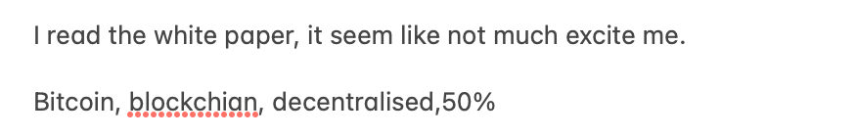
Assignment:1.Read all chapters of “21 Lessons” and the Bitcoin whitepaper.
1b.Summarize your key learnings from the Bitcoin whitepaper in your own words.

Slide 18
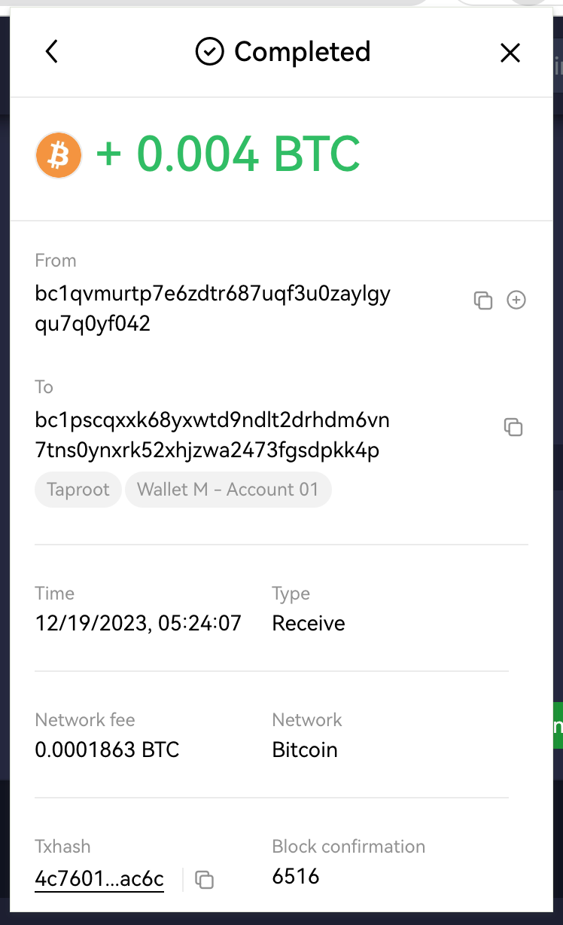
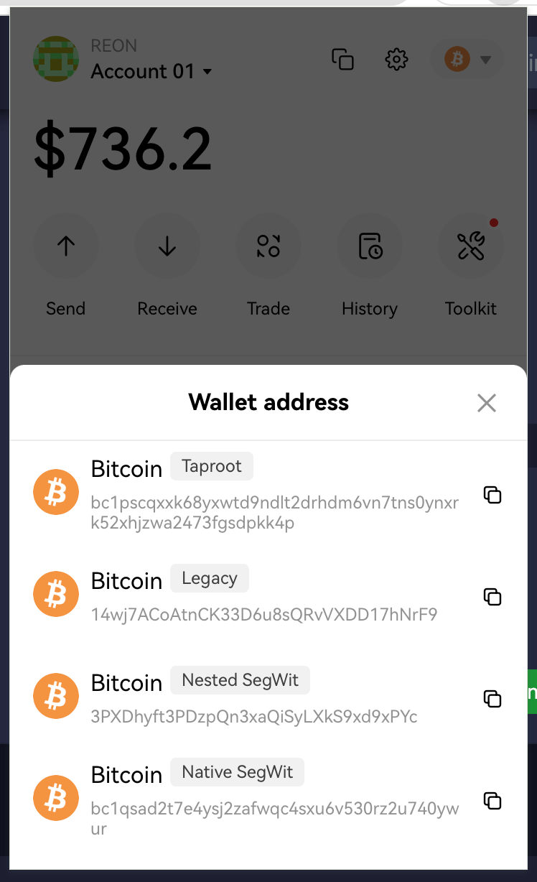
Assignment 2.Practical: Bitcoin transaction
2a.Obtain a Bitcoin address and send there some fractions of a Bitcoin.

Slide 19
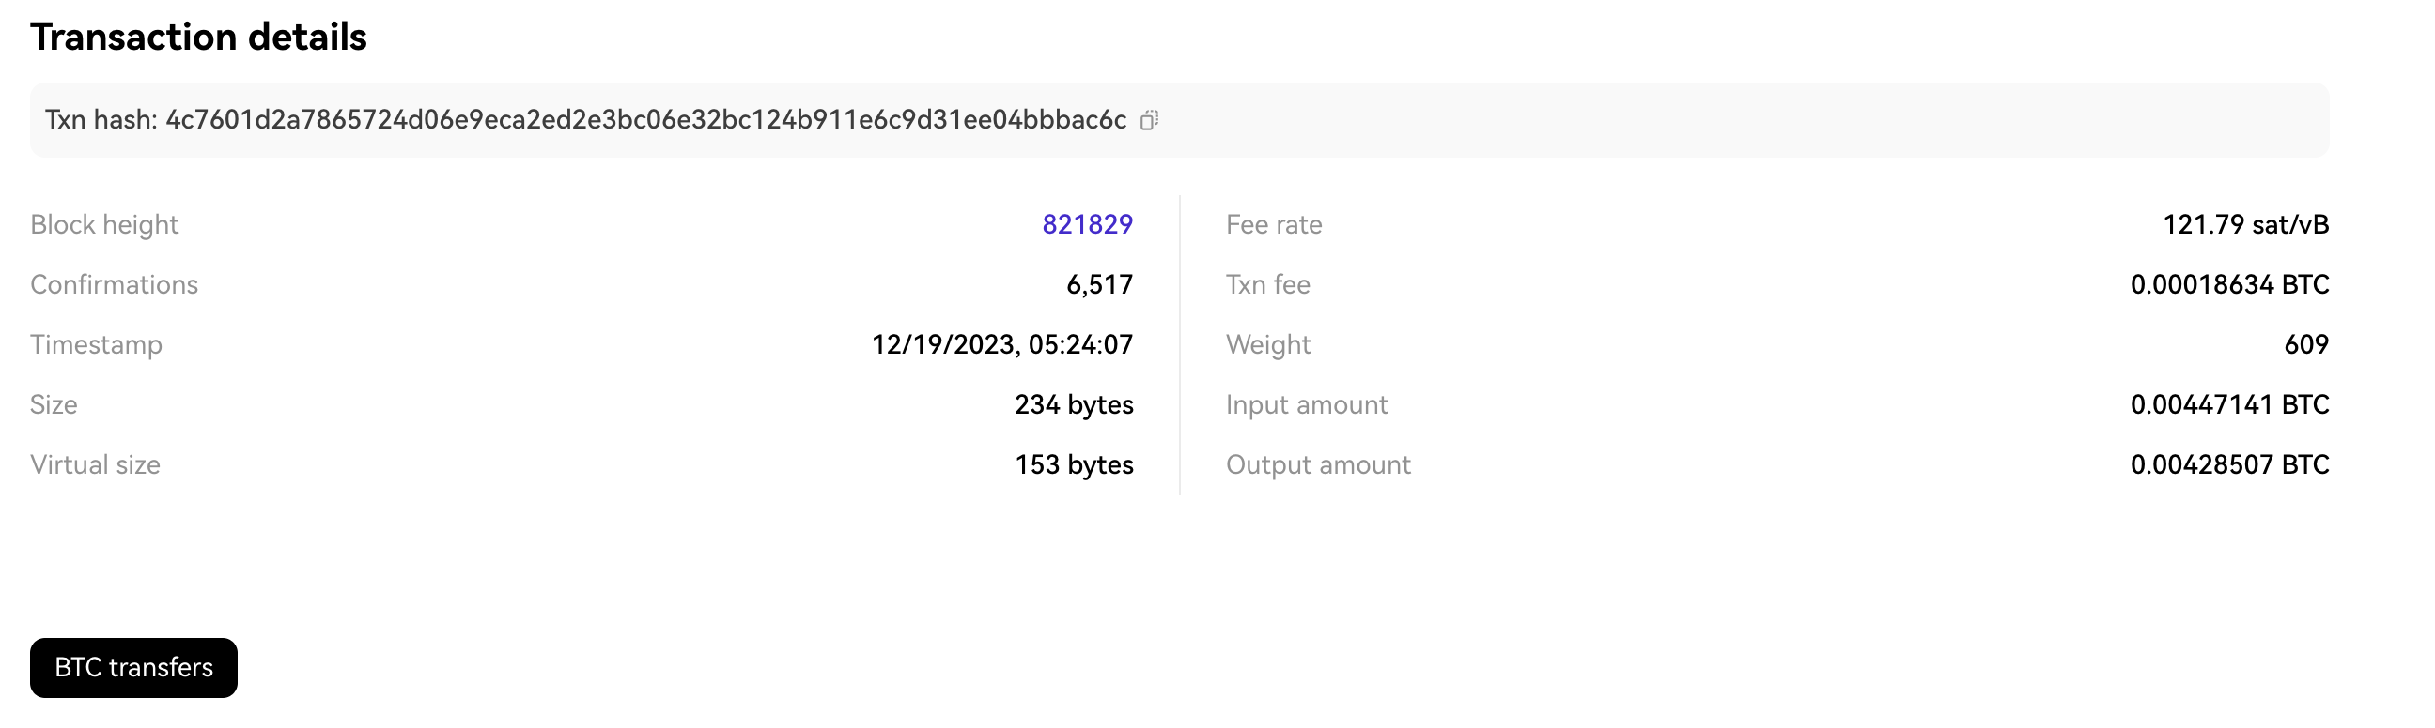
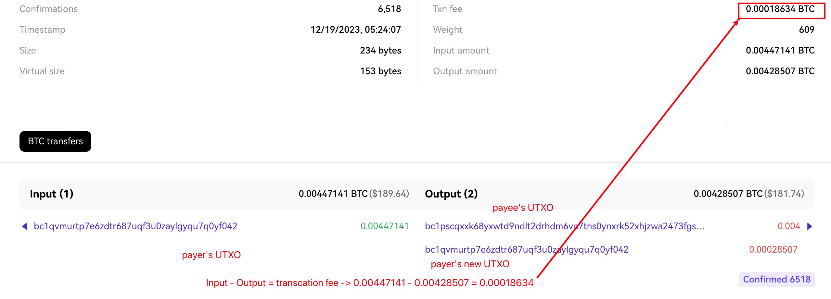
Assignment 2.Practical: Bitcoin transaction
2b.Observe the transactions on the block explorer.

Slide 20
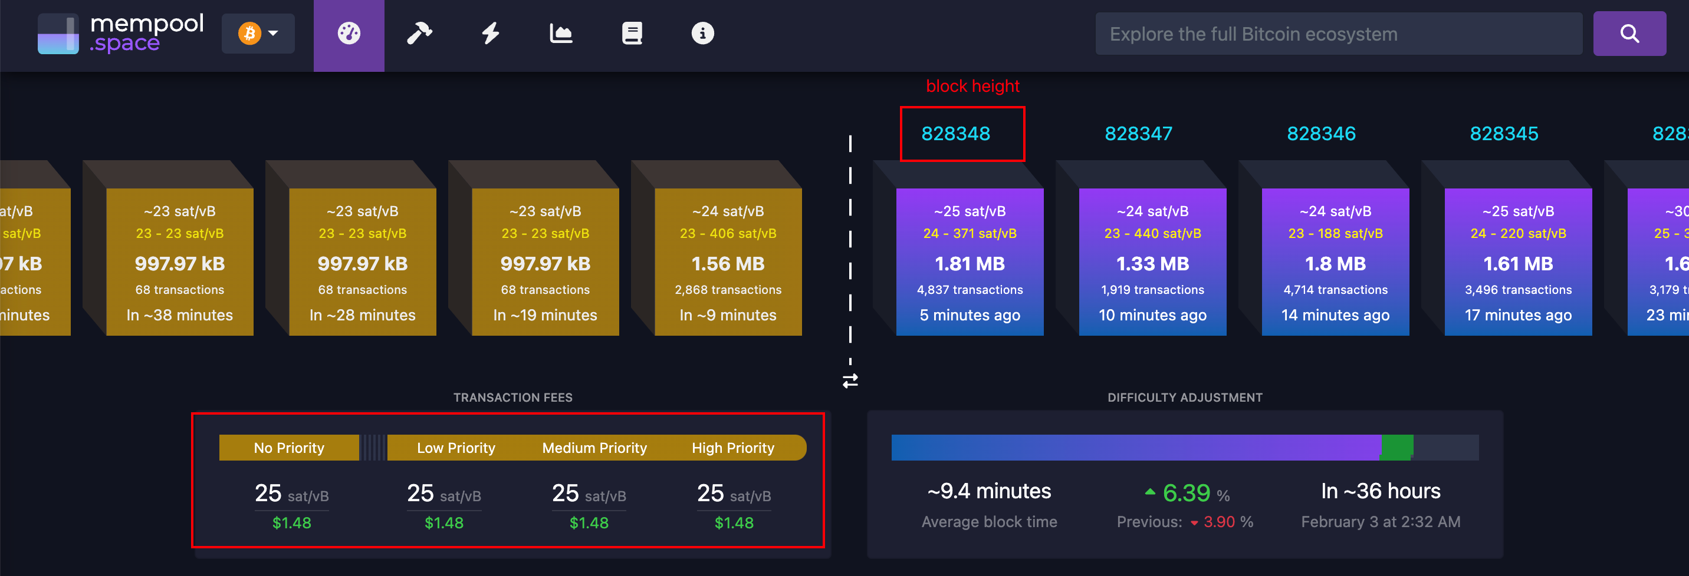
Assignment 2.Practical: Bitcoin transaction
2c.Also observe the mempool.

Slide 21
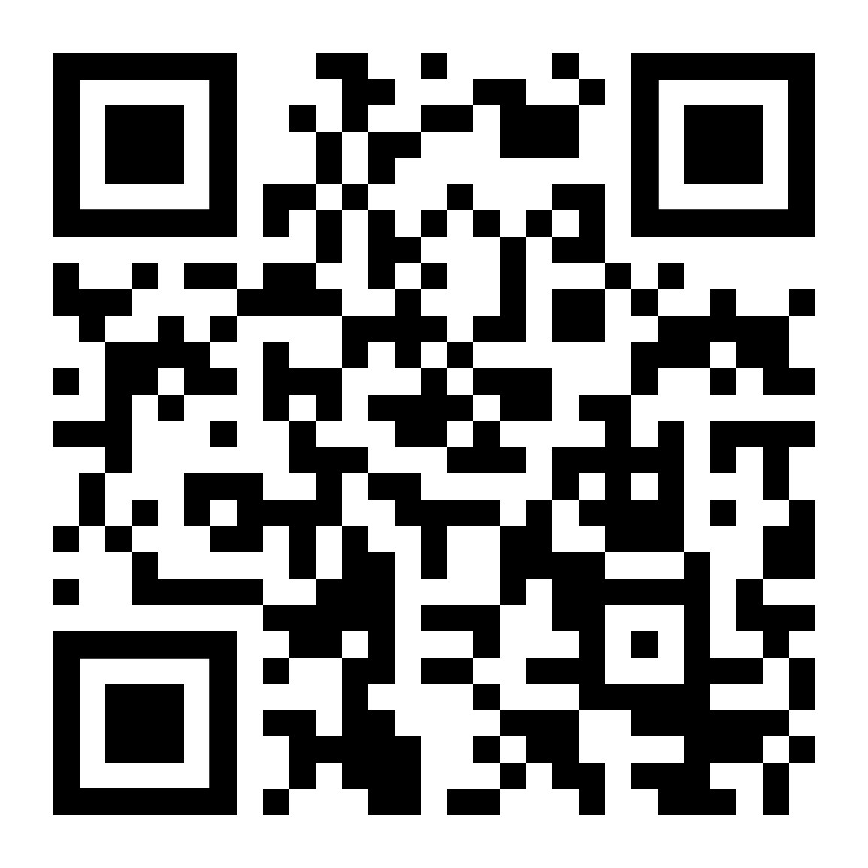
Submit Assignment
https://forms.gle/iRNjCf8TCHi8My7v5

Slide 22
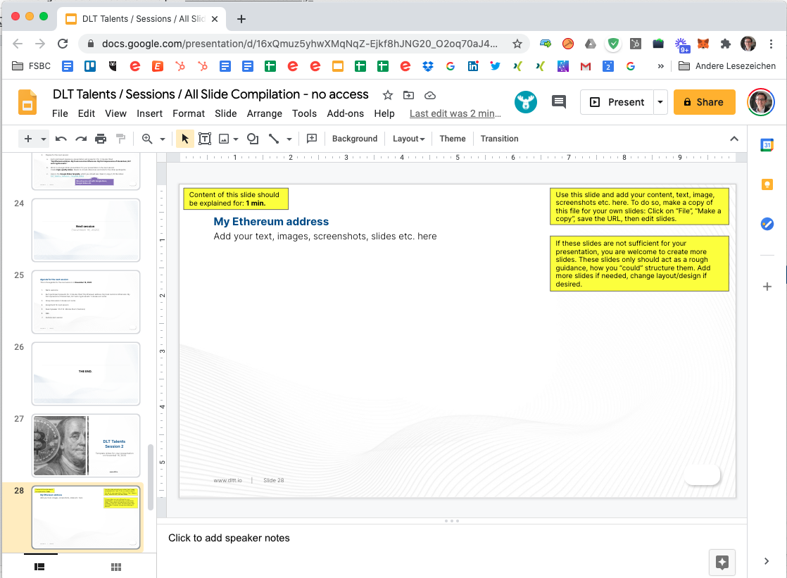
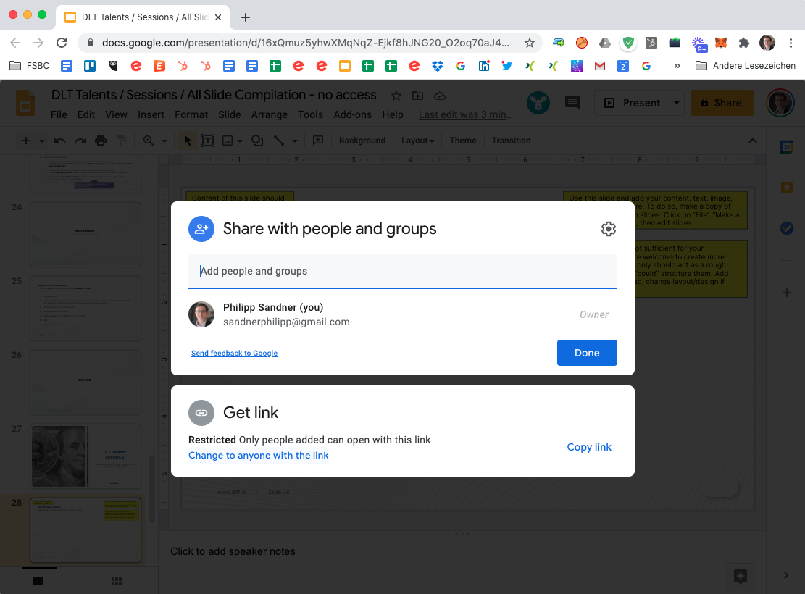
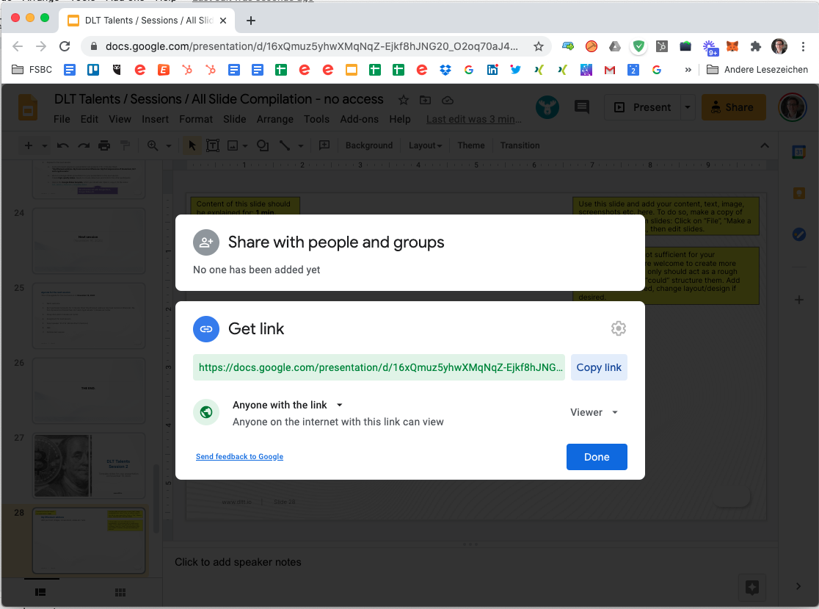
How can you share a Google Slides presentation?
With a few click within Google Slides you can generate an internet link so that others can view your slides. You can also allow or prevent editing as you wish.
1
2
5
3
4

Slide 23




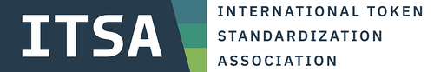




Next: Session 2
ORGANIZED BY
Follow us on
February 7, 2024
Supported by

